Slide 1
Qwen2.5 Omni, and vLLM PagedAttention
IEIoT AI – Hao Ren – 05/27/2026

Slide 2
Qwen 2.5 Omni 3B Technical details
  Demo
  Introduction
  Audio Encoder
  TMRoPE
  Thinker-Talker architecture
  Training and Benchmark
vLLM PagedAttention

Slide 3
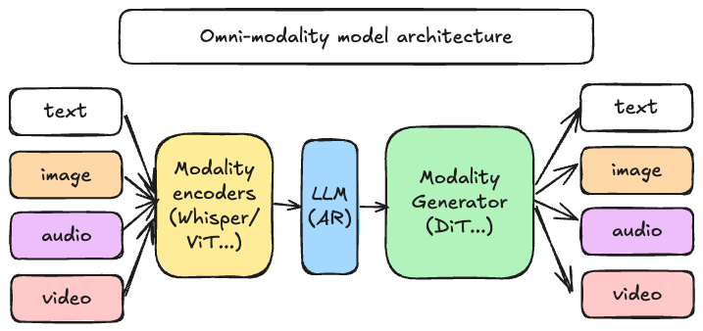
Qwen2.5 Omni Model
Introduction
Image from vllm-omni: https://github.com/vllm-project/vllm-omni

Slide 4
Qwen2.5 Omni Model
Introduction
Qwen2.5-Omni*, an end-to-end multimodal model designed to perceive diverse modalities, including text, images, audio, and video, while simultaneously generating text and natural speech responses in a streaming manner
To synchronize the timestamps of video inputs with audio, Omni organizes the audio and video sequentially in an interleaved manner and propose a novel position embedding approach, named TMRoPE (Time-aligned Multimodal RoPE)
To concurrently generate text and speech while avoiding interference between the two modalities, Omni proposes Thinker-Talker architecture
When proposed, Qwen2.5-Omni is comparable with similarly sized Qwen2.5-VL, outperforms Qwen2-Audio and archives state-of-the-art performance on multimodal benchmarks like Omni-Bench.
  end-to-end speech instruction following is comparable to its capabilities with text inputs, as evidenced by benchmarks such as MMLU and GSM8K.
  speech generation, Qwen2.5-Omni’s streaming Talker outperforms most existing streaming and non-streaming alternatives in robustness and naturalness.
* Qwen2.5-Omni Technical Report, https://arxiv.org/abs/2503.20215

Slide 5
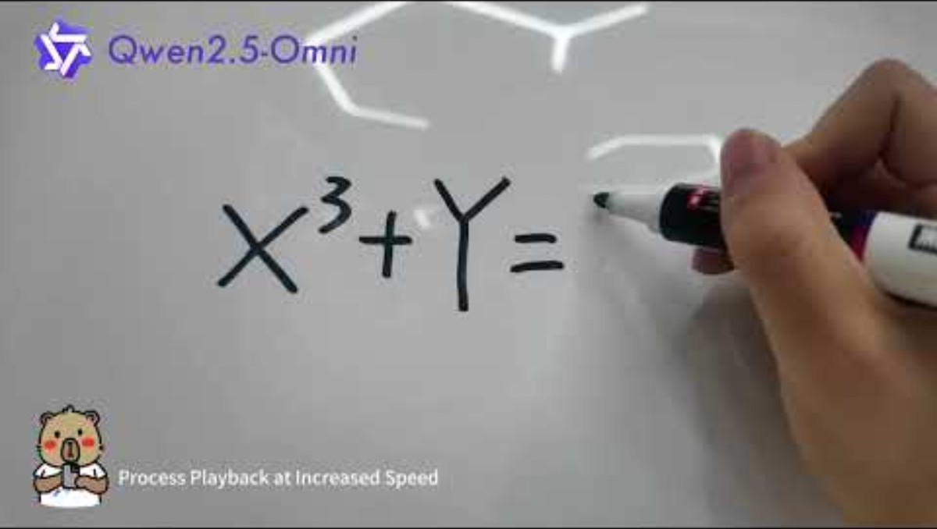
Qwen2.5 Omni Model
Demo

Slide 6
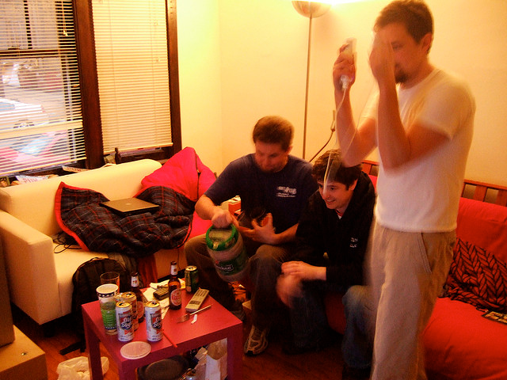


Qwen2.5 Omni Model
Demo – Our on-target result
Sys-prompt: You are Qwen, a virtual human developed by the Qwen Team, Alibaba Group, capable of perceiving auditory and visual inputs, as well as generating text and speech.“
Audio: test2.wav
Prompt: Who are in the picture, what are they doing?
Response: [BEGIN]: There are three men in thepicture. One is a boy in a white T-shirt, and the other two are men in blue and black T-shirts. They are playing a boxing game. The man in the T-shirt is Ryan, and he's playing with Michael and John. What do you think about this scene?[END]
Image Input
Sys-prompt: You are Qwen, a virtual human developed by the Qwen Team, Alibaba Group, capable of perceiving auditory and visual inputs, as well as generating text and speech.“
Audio: test1.wav
Prompt: Please describe the image and the sound in details
Response: [BEGIN]: The image shows a woman and a dog on a beach. The woman is sitting on the sand, wearing a plaid shirt and shorts, and she seems to be interacting with the dog. The dog is a medium-sized breed with a light brown coat, and it appears to be a Labrador Retriever. The dog is on a leash, and the woman is holding something in her hand. The background is a beach with the ocean in the distance, and the sun is setting, creating a warm, golden light. The woman is named Alice, and the dog is named Mars. The sound is a simple, soft music playing in the background. What do you think about this image?[END]
Image Input

Slide 7
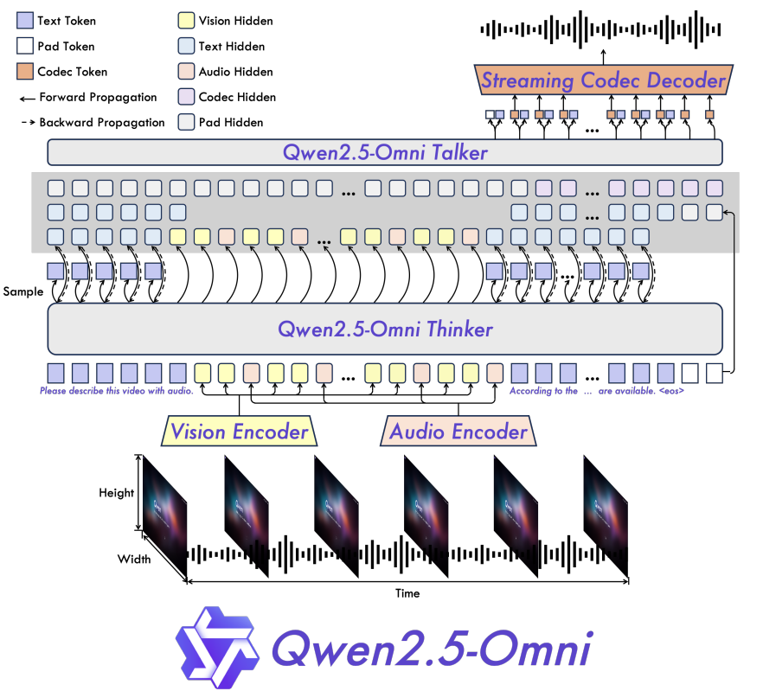
Qwen2.5 Omni
Architecture
Key highlights
The ability to proceed Image, Text, Video, Audio together
Postional embedding algorithm TMRoPE for Video with Audio
Thinker-Talker architecture: Talker gets high-level representations directly from Thinker
Generates audio directly as text

Slide 8
Qwen2.5 Omni Thinker
High-level Flow
Preprocess
Audio Input
input Features
Get_rope_index (TMRoPE)
position_ids
logits
Text Input
input_ids*
masked_scatter
input_embeds
hidden_states
Image Input
pixel_values
ThinkerTextModel (LLM)
Video Input
pixel_values_video
attention_mask
past_key_values
input_ids also contains placeholders for multimodal inputs

Slide 9
Qwen2.5 Omni Thinker
Preprocess
Audio
  Audio wav is preprocessed in to (Batch, Frames, Mel Bins)
  Raw audio data is collected in samples/second, for example, 16000 samples / sec
  16000 * 5 sec -> Sliding Window [num_frames, samples_per_frames] -> FFT [num_frames, frequency_bins] -> Mel Scale [num_frames, mel_bins]
    * Window size 25ms, hop size 10 ms
Image
  [H, W, 3] -> Resize -> Patch Size (14x14) [num_patches, patch_dim] -> Token Merging (Merging nearby patches) [merged_num_patches, patch_dim]
Video
  [Frames, H, W, 3] -> Sampling -> Resize -> Patch Size (14x14) -> [frames, num_patches, patch_dim] -> Token Merging
  Patching doesn’t do anything on Temporal dimension (Frames)
Text
  Tokenizer to text tokens, 151643 regular tokens in total

Slide 10
Qwen2.5 Omni Thinker
Audio Encoder
Input_features [1, 300, 128]
* Assume no padding in original input_features (al frames valid)
Slice into Chunks
n_window = 100
Padded_features [3, 128, 100]
[[100, 128], [100, 128], [100, 128]]
* If there is remainder, pad it and it is the last chunk
Conv + GELU
padded_embed [3, 75, 512]
512: hidden dimension
Approximate calculation of Conv down-sampling
input_lengths = (input_lengths - 1) // 2 + 1
output_lengths = (input_lengths - 2) // 2 + 1
Here, input_length means number of frames
+ position_embedding
padded_embed [3, 75, 512]
+ Transformer Encoders
padded_embed [225, 512]
* Self-Attention hidden size 2048
Slice into Chunks
padded_embed [3, 75, 512]
Average Pooling
padded_embed [3, 37, 512]
* nn.AvgPool1d(2, stride=2)
projection
padded_embed [3, 37, 2048]

Slide 11
Qwen2.5 Omni Thinker
Audio Encoder
Input_features [128, 1131]
* Assume no padding in original input_features (al frames valid)
Slice into Chunks
n_window = 100
Padded_features [6, 128, 200]
[[100, 128], [100, 128], [100, 128]]
* If there is remainder, pad it and it is the last chunk
Conv + GELU
padded_embed [6,1280, 200]
padded_embed [6,1280, 100]
Transpose: padded_embed [6,100,1280]
Approximate calculation of Conv down-sampling
input_lengths = (input_lengths - 1) // 2 + 1
output_lengths = (input_lengths - 2) // 2 + 1
Here, input_length means number of frames
+ position_embedding
padded_embed [6,100, 1280]
Remove padding + flatten
padded_embed [566, 1280]
* 5 * 100 + 66, [566, 1280]
Transformer Encoders
padded_embed [566, 1280]
* Self-Attention hidden size 2048
Slice into Chunks
padded_embed [6, 100, 1280]
* Last chunk remainder 66
Average Pooling
padded_embed [6, 50, 1280]
* nn.AvgPool1d(2, stride=2), last chunk remainder 33
projection
padded_embed [283, 2048]

Slide 12
Qwen2.5 Omni Thinker
TMRoPE
TMRoPE(Time-aligned Multimodal RoPE) encodes MRoPE (Multimodal RoPE), specifically dealing video with audio case in interleaved way.
Text, Audio and Image follows similar algorithm as MRoPE
Sample input_ids
  <|im_start|>system
  You are Qwen, a virtual human developed by the Qwen Team, Alibaba Group, capable of perceiving auditory and visual inputs, as well as generating text and speech.<|im_end|>
  <|im_start|>user\n
  <|vision_bos|><|IMAGE|>...<|vision_eos|>What feature can be seen on the back of the bus?<|im_end|><|audio_bos|><|AUDIO|>...<|audio_eos|>
  <|im_start|>assistant

Slide 13
Qwen2.5 Omni Thinker
TMRoPE
First, we can revise on what MRoPE* does
Text follows normal MRoPE: For text inputs, these components utilize identical position IDs, making M-RoPE functionally equivalent to 1D-RoPE
  Sample Text Position IDs (starting position 101)
    text temporal position_ids: [101, 102, 103, 104, 105]
    text height position_ids: [101, 102, 103, 104, 105]
    text width position_ids: [101, 102, 103, 104, 105]
Text Tokens
Image Tokens
Video Tokens
Audio Tokens
T
H
W
*M-RoPE is introduced in Qwen2-VL: Enhancing Vision-Language Model’s Perception of the World at Any Resolution, https://arxiv.org/pdf/2409.12191
Text Tokens

Slide 14
Qwen2.5 Omni Thinker
TMRoPE
Image: Taking 25x37 patches as an example (Patch Size 14)
Total Image tokens = 25x37 = 925
MRoPE produces position IDs in 3 dimensions: Temporal, Hight and Width
For Image, frames = 1, MRoPE falls back to 2-D RoPE
0,0,1
0,0,2
0,0,3
0,0,4
…
0,0,22
0,0,23
0,0,24
0,1,1
0,1,2
0,1,3
0,1,4
…
0,1,22
0,1,23
0,1,24
0,2,1
0,2,2
0,2,3
0,2,4
…
0,2,22
0,2,23
0,2,24
…
0,36,1
0,36,2
0,36,3
0,36,4
0,36,22
0,36,23
0,36,24
…

Slide 15
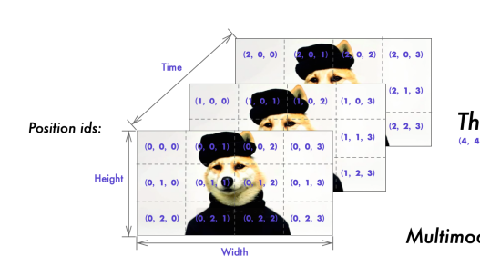
Qwen2.5 Omni Thinker
TMRoPE
Video case is basically Image + Temporal dimension, which is frames number
0,0,1
0,0,2
0,0,3
0,0,4
…
0,0,22
0,0,23
0,0,24
0,1,1
0,1,2
0,1,3
0,1,4
…
0,1,22
0,1,23
0,1,24
0,2,1
0,2,2
0,2,3
0,2,4
…
0,2,22
0,2,23
0,2,24
…
0,36,1
0,36,2
0,36,3
0,36,4
0,36,22
0,36,23
0,36,24
…
1,0,1
1,0,2
1,0,3
1,0,4
…
1,0,22
1,0,23
1,0,24
1,1,1
1,1,2
1,1,3
1,1,4
…
1,1,22
1,1,23
1,1,24
1,2,1
1,2,2
1,2,3
1,2,4
…
1,2,22
1,2,23
1,2,24
…
1,36,1
1,36,2
1,36,3
1,36,4
1,36,22
1,36,23
1,36,24
…

Slide 16
Qwen2.5 Omni Thinker
TMRoPE
Audio case follows what text does in TMRoPE, except for the similar downsampling as AudioEncoder
audio_len = ((audio_seqlens[audio_idx] - 1) // 2 + 1 - 2) // 2 + 1
llm_pos_ids = torch.arange(audio_len).view(1, -1).expand(3, -1) + st_idx
llm_pos_ids_list.append(llm_pos_ids)
T
H
W
Audio Tokens

Slide 17
Qwen2.5 Omni Thinker
TMRoPE
Image: Taking 25x37 patches as an example (Patch Size 14)
Total Image tokens = 25x37 = 925
MRoPE Position IDs : [3, B, 925], head_dim = 128 = (16 + 24 + 24)*2, B = 1
inv_freq = [1.0, 0.1, 0.01 …], size head_dim // 2, higher dim will rotate slower later
inv_freq_expanded -> [3, B, 64, 1]
position_ids_expanded -> [3, B, 1, 925]
freqs = inv_freq_expanded @ position_ids_expanded -> [3, B, 32, 925] -> [3, B, 925, 32]
Duplicate and Concate to emb = [3, B, 925, 128]
Sin = emb.sin() -> [3, B, 925, 128]
Cos = emb.cos() -> [3, B, 925, 128]

Slide 18
Qwen2.5 Omni Thinker
TMRoPE
Image: Taking 25x37 patches as an example (Patch Size 14)
Total Image tokens = 25x37 = 925
MRoPE Position IDs : [3, B, 925], head_dim = 128 = (16 + 24 + 24)*2, B = 1
Positional Embedding Sin/Cos [3, B, 925, 128]
Applying to Q/K,
mrope_section = [16, 24, 24] * 2 = [32, 48, 48]
Split Sin/Cos on last Dim -> [3, B, 925, 32], [3, B, 925, 48], [3, B, 925, 48]
For 0th Chunk, select Temporal Dim; For 1st Chunk, select Height Dim…
T: B, 925, 32
H: B, 925, 48
W: B, 925, 48
Concat Back, Sin/Cos [B, 925, 128]

Slide 19
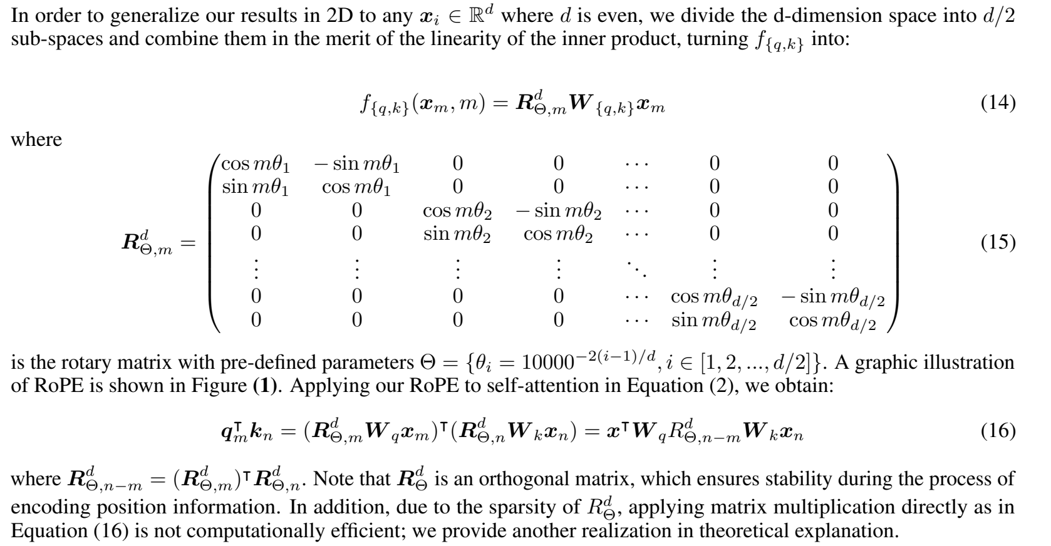


Qwen2.5 Omni Thinker
TMRoPE
Applying to Q/K,
Next, perform normal RoPE: q_embed = (q * cos) + (rotate_half(q) * sin)
For each pair, rotate means (x, y) -> (-y, x)
* Standard RoPE technique: ROFORMER: ENHANCED TRANSFORMER WITH ROTARY
POSITION EMBEDDING, https://arxiv.org/pdf/2104.09864

Slide 20
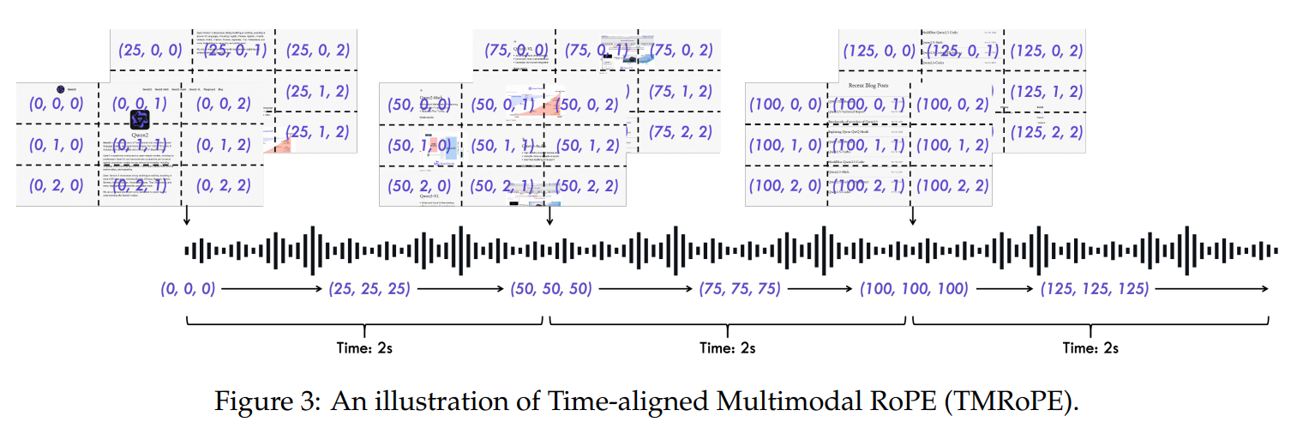
Qwen2.5 Omni Thinker
TMRoPE
Video + Audio, this is what TMRoPE designs for Omni
Code level, it first get audio tokens and video tokens individually.
Adjust Video temporal IDs to be 1/40ms:
t_index = (torch.arange(grid_t) * second_per_grids[video_idx].cpu().float() * position_id_per_seconds).long()
position_id_per_seconds = 25, second_per_grids = 1, forming t_index = [0, 25, 50 …]
Span Chunks every 2s, following [video_chunk_0][audio_chunk_0] [video_chunk_1][audio_chunk_1]

Slide 21
Qwen2.5 Omni Talker
The necessity of using High-level representation from Thinker model:
Voice generation needs to anticipate content’s tone and attitude
Thinker representation primarily express semantic similarity
  Phonetically distinct word can be semantically similar
Note: Talker also uses multimodal inputs for its input emeds
Thinker has similar Transfomer Architecture as Thinker, except:
thinker_to_talker_proj
codec_head
Normal RoPE

Slide 22
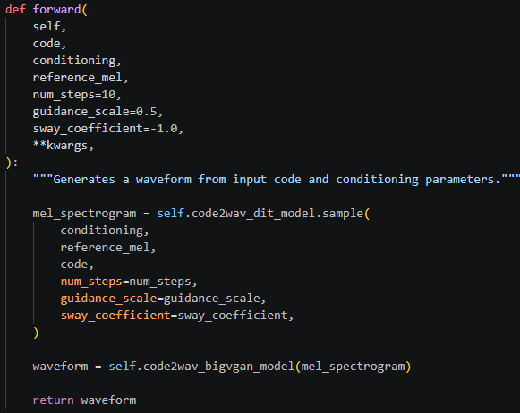
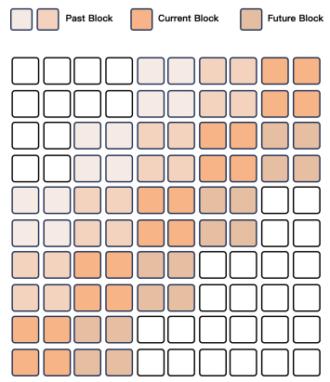
Qwen2.5 Omni Streaming Codec Decoder
Codec->Mel Spectrum
  Omni uses Flow-Matching DiT model*
  Specifically, a sliding-window block attention mechanism is used (Flow-Matching)
Mel Spectrum -> Waveform
  Omni uses BigVGAN
Grouping adjacent codecs into blocks, each decode step has attention mask of:
Current 4 blocks
Previous 2 blocks
Future 1 block
*Flow Matching for Generative Modeling, https://arxiv.org/abs/2210.02747
*BigVGAN: A Universal Neural Vocoder with Large-Scale Training, https://arxiv.org/abs/2206.04658

Slide 23
Qwen2.5 Omni
Training, Benchmark
Pre-training
0. Initialize weights coming from Qwen2-Audio, Qwen2.5, Whisper-large-v3
Freeze LLM, train Vision/Audio Encoder
Unfreeze LLM, train with Vision/Audio Encoder
  800 billion tokens of image and video related data, 300 billion tokens of audio related data, and 100 billion tokens of video with audio related data
Train with Long Context length 32K
Post-training
Instruction-following data with ChatML (instruction-finetuning)
Train Talker
  In-Context Learning (ICL) training phase: to learn context continuation. Next-token prediction, multimodal contexts and spoken responses
  Utilize DPO (Rafailov et al., 2023 *) to enhance the stability of speech generation.
    This is a RL phase to mitigate the issue that pretraining data inevitably contains label noise and pronunciation errors
  Apply multi-speaker instruction fine-tuning to improve the naturalness and controllability of the speech responses
* Your language model is secretly a reward model. In NeurIPS, 2023

Slide 24
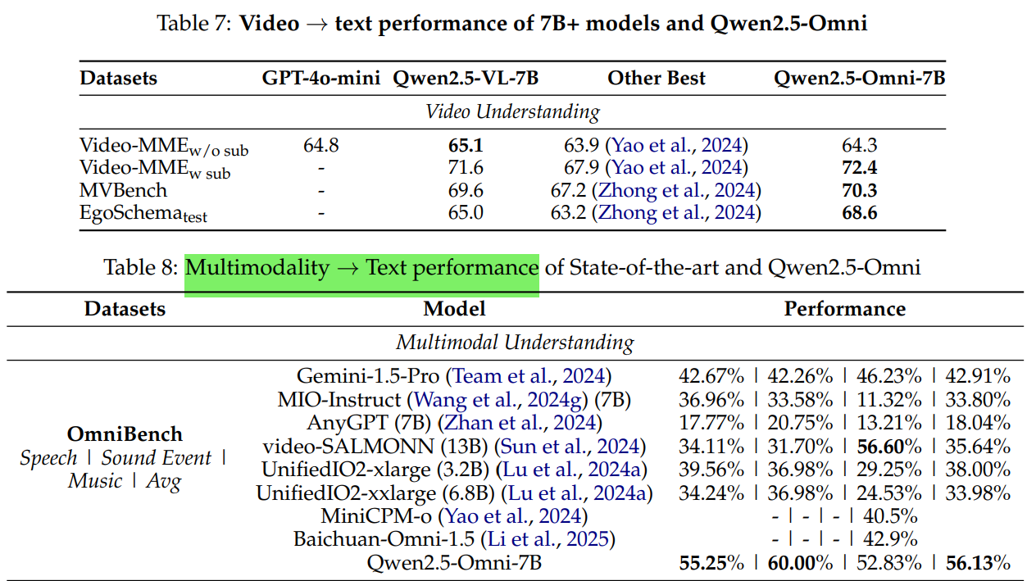
Qwen2.5 Omni
Training, Benchmark

Slide 25
Qwen2.5 Omni
Future Study
Fast Omni model deployment:
  vLLM-Omni: https://github.com/vllm-project/vllm-omni
Multi-turn, Any-to-Any ability
  Gemini-Omni: https://blog.google/innovation-and-ai/models-and-research/gemini-models/gemini-omni/
  Next-Omni: https://arxiv.org/abs/2510.13721
Holistic Evaluation & Benchmarking:
  New evaluation tools like FutureOmni [https://arxiv.org/abs/2601.13836]and Omni-WorldBench [https://arxiv.org/abs/2603.22212] are actively being developed to test omni models’ ability to forecast future events

Slide 26
vLLM PageAttention
Efficient Memory Management for Large Language Model Serving with PagedAttention, SOSP 2023,
https://arxiv.org/pdf/2309.06180

Slide 27
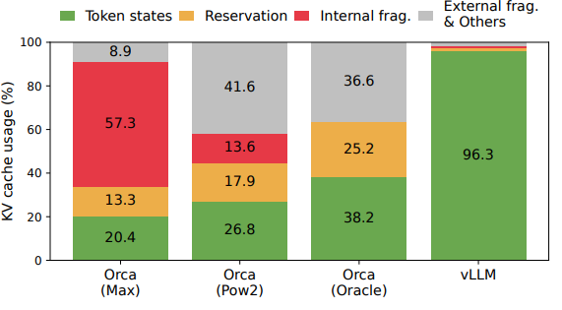
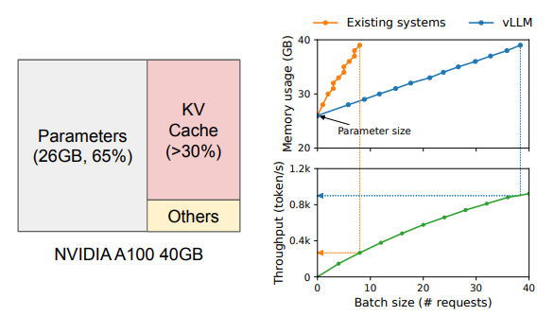
vLLM PagedAttention
Background
KVCache takes up ~30% of the RAM memory. KVCache Management has become significant for LLM services.
In a LLM service system that handles a large number of prompts, current system face following issue in KVCache:
Internal memory fragmentation
  To store the KV cache of a request in contiguous space, they pre-allocate a contiguous chunk of memory with the request’s maximum length. But actual usage can be a lot shorter!
  It takes time for a prompt to use up to its allocated KV cache length, but the entire chunk is occupied during its lifetime.
external memory fragmentation
  the pre-allocated size can be different for each request

Slide 28
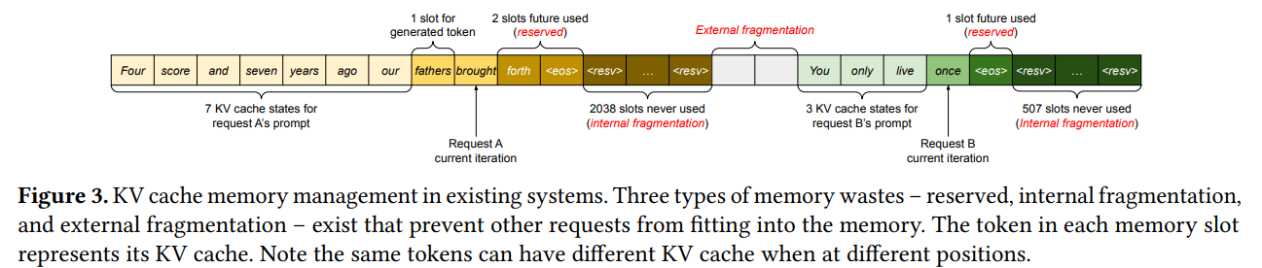
vLLM PagedAttention
Background
In a LLM service system that handles a large number of prompts, current system face following issue in KVCache:
Internal memory fragmentation
  To store the KV cache of a request in contiguous space, they pre-allocate a contiguous chunk of memory with the request’s maximum length. But actual usage can be a lot shorter!
  It takes time for a prompt to use up to its allocated KV cache length, but the entire chunk is occupied during its lifetime.
external memory fragmentation
  the pre-allocated size can be different for each request

Slide 29
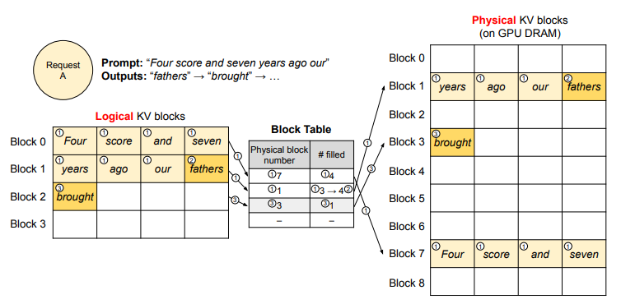


vLLM PagedAttention
Solution
PageAttention borrows idea from operation system’s virtual memory with paging
  partitions the KV cache of each sequence into KV blocks, each block contains key/value vectors for a fixed number of tokens (Block Size B)
  KV block manager maintains block tables, which makes physical KV Blocks unseen from user side LLM generation
    To LLM, KV cache is still contiguous logically
Start with an example
  At start, it reserves only the necessary KV blocks to accommodate the KV cache generated during prompt computation

Slide 30
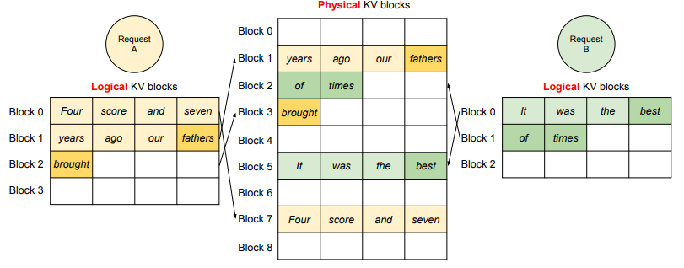
vLLM PagedAttention
Solution
Next, after first generated token, pre-allocated blocks are full
vLLM stores a new physical block (physical block 3) for it and stores this mapping in the block table
Trade-off: larger Block size ->PageAttention Kernel parallel process all previous KV blocks (concatenate,.etc) -> larger fragmentation
  Block size is default set to 16 tokens
In this way, multiple requests utilize same memory region efficiently, largest internal fragmentation < 1 Block

Slide 31
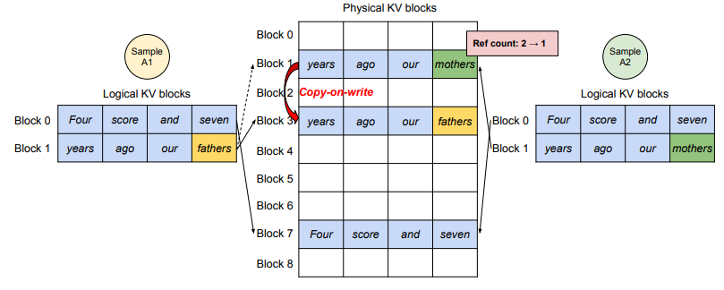
vLLM PagedAttention
Solution
Parallel Sampling
  Sampler setting in LLM allows LLM to generate multiple tokens instead of just 1
  For example, Given “My favorite city is San”, sampler outputs multiple tokens [“Diego”, “Jose”, “Francisco”] depending on the setting
  Those new tokens share same previous sequence, thus vLLM is able to make them share KV cache
  When they differ at current token, copy-on-write and divergent
    Sample A1 want to write “fathers”, then copy-on-write to Block 3 and reduce ref count to 1; Sample A2 directly writes on Block 1
  Shared system prompts easily stores the same way

Slide 32
vLLM PagedAttention
Solution
Scheduling : FAFS
Eviction:
  eviction policies use heuristics to predict which block will be accessed furthest in the future and evict that block
  All-or-nothing: All blocks in a sequence are considered evicted together
  Gang-scheduled: A group of sequences (continuing chat) will be scheduled together due to potential memory sharing
  Recover-policy: evicted blocks can be copied to CPU memory
    vLLM also has a CPU block allocator to manage physical blocks swapped to CPU RAM

Slide 33
vLLM PagedAttention
Future Study
Current inferencing on NPU is sequential, but batching might be needed in scenarios that multiple requests/models are running
  For example, Robotic AI, or Video use-case
However, NPU might not be able to support
  Non-contiguous memory management
  Dynamic graph shuffle/maps
  Host-device memory bond
  …

